Slide 1
Railway Reservation System
TEAM MEMBERS:-
SAGAR AHUJA
JOSHUA JOSEPH
PIYUSH THAKUR
GYAN PUNJ
AMAN KUMAR RASTOGI
TORRY HARRIS BUSINESS SOLUTION

Slide 2
PROBLEM STATEMENT:-
The application should take train number and passenger details as input.
The details of the train should be stored in a database. The train details to be stored in database are Train number, Train Name, Source Station, Destination Station and Ticket Price.
The train details should be fetched from the database using the train number provided by the user.
ABOUT PROJECT:- The purpose of this source is to describe the railway reservation system, which provides the train timing details, reservation, billing and cancellation on various types of reservation namely. In addition, This Railway reservation service will not only enhance the reservation but will also help the commuters in getting support, refunds and other real time fixes.

Slide 3
Minimum Hardware Requirements:-
Processor Intel i3
HDD 40GB
RAM 128 MB
Cache 1 MB
Technologies used:--
HTML
CSS
Bootstrap
Java Script
JAVA
Springboot

Slide 4
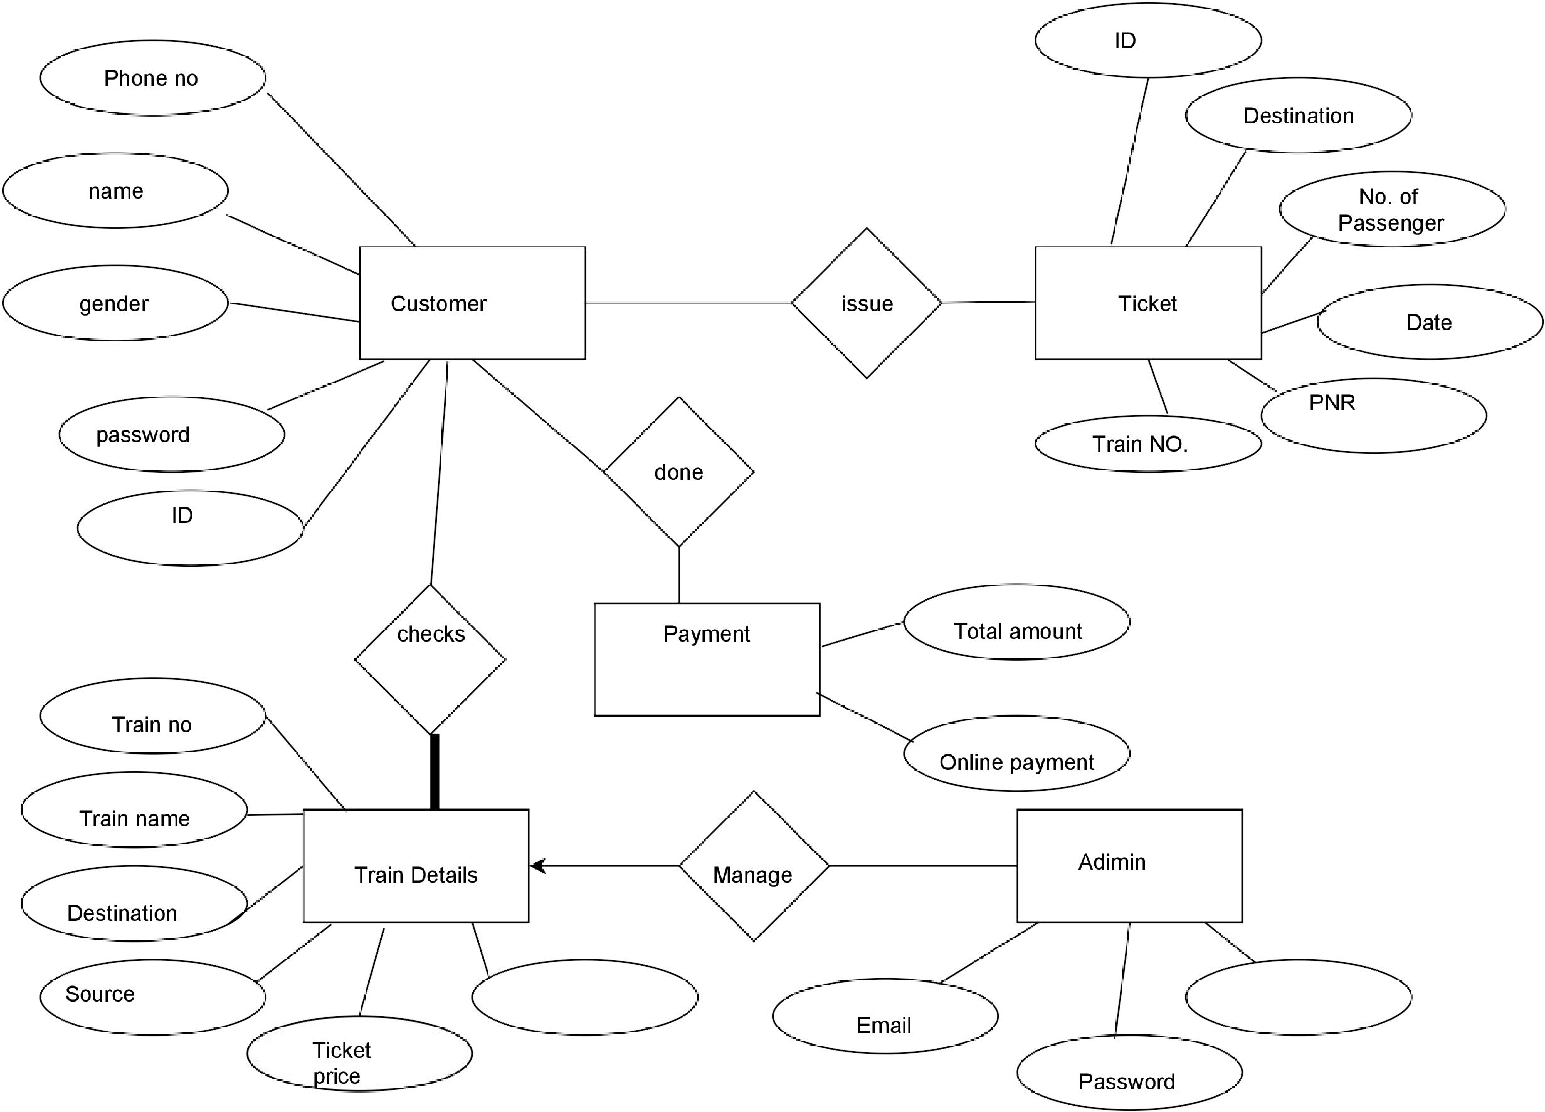

Slide 5
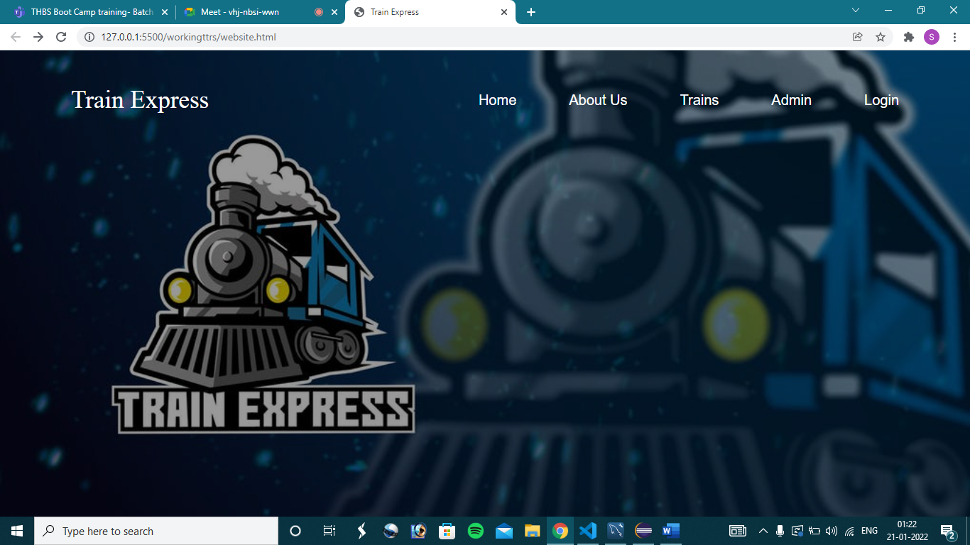
HOME PAGE

Slide 6
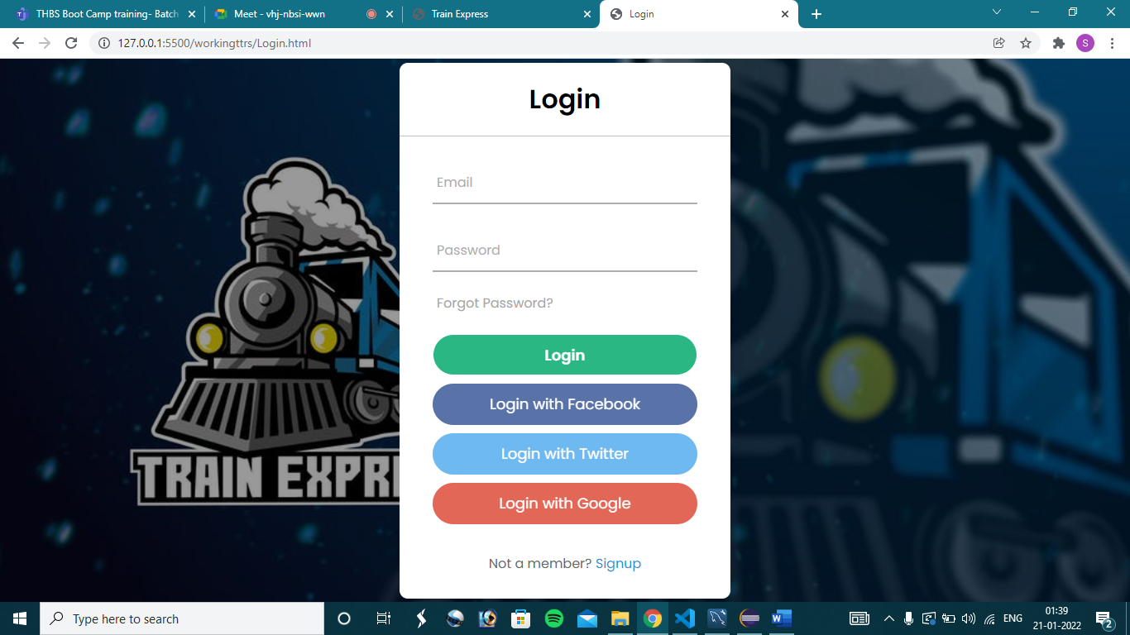
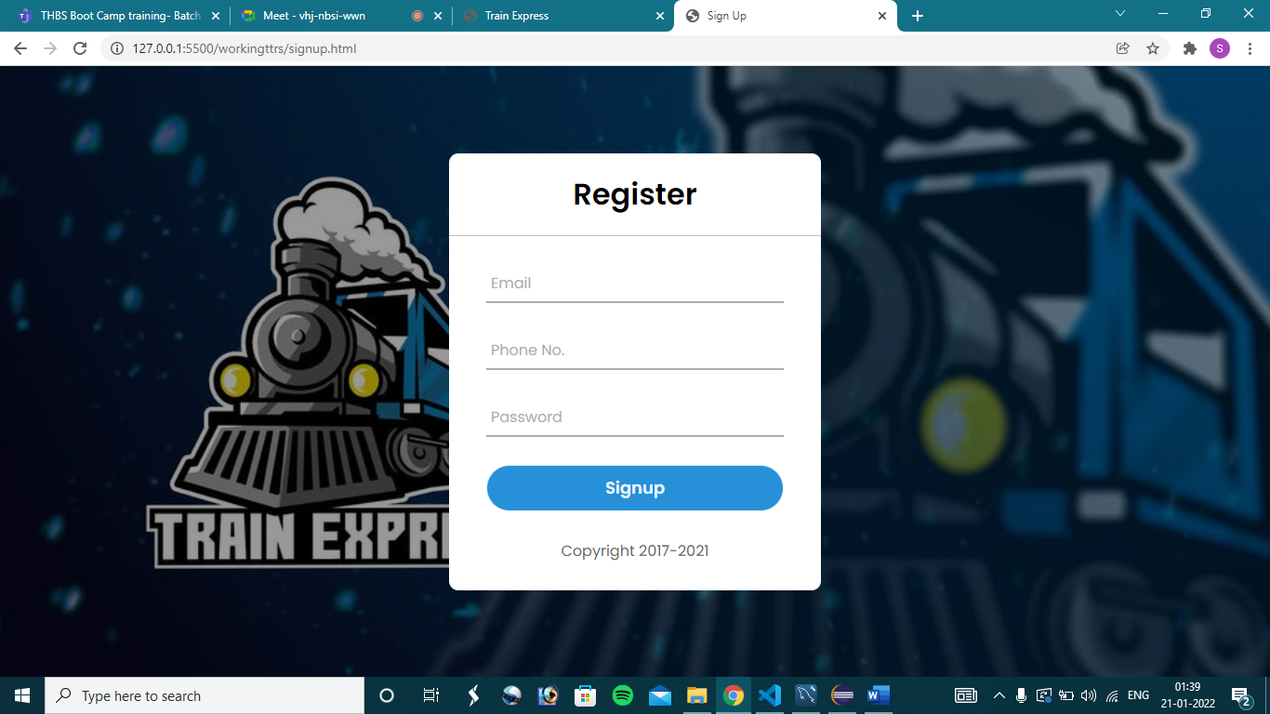

Slide 7
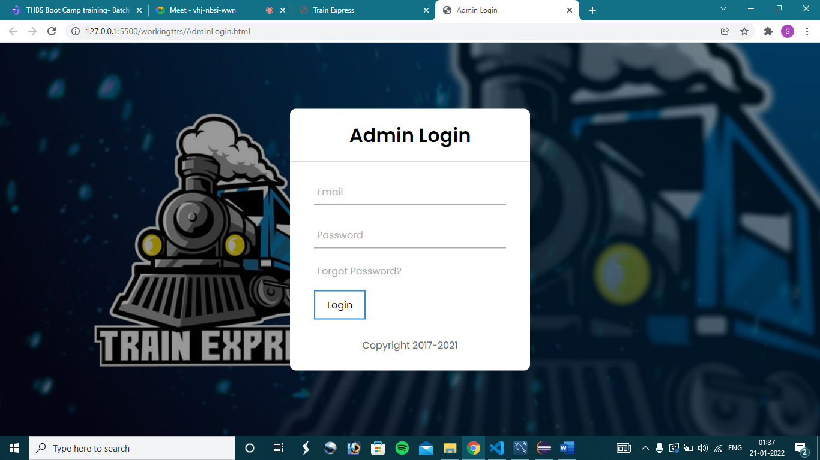
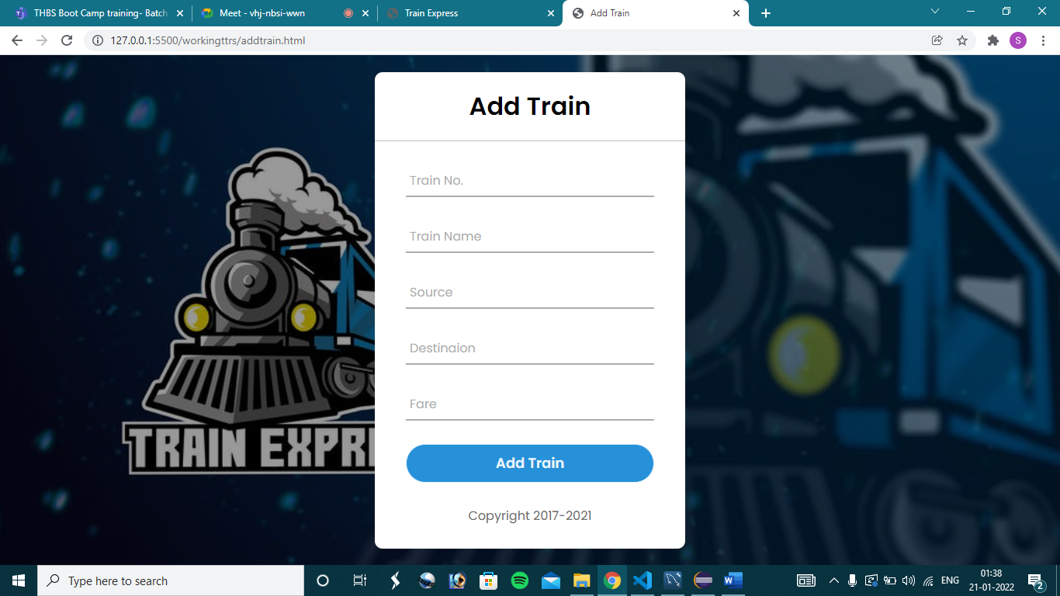

Slide 8
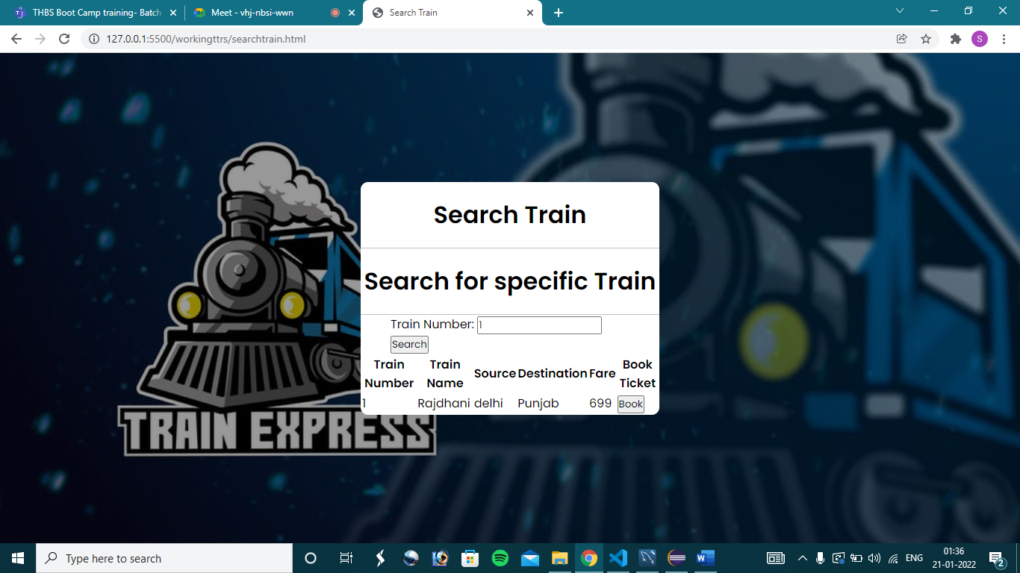
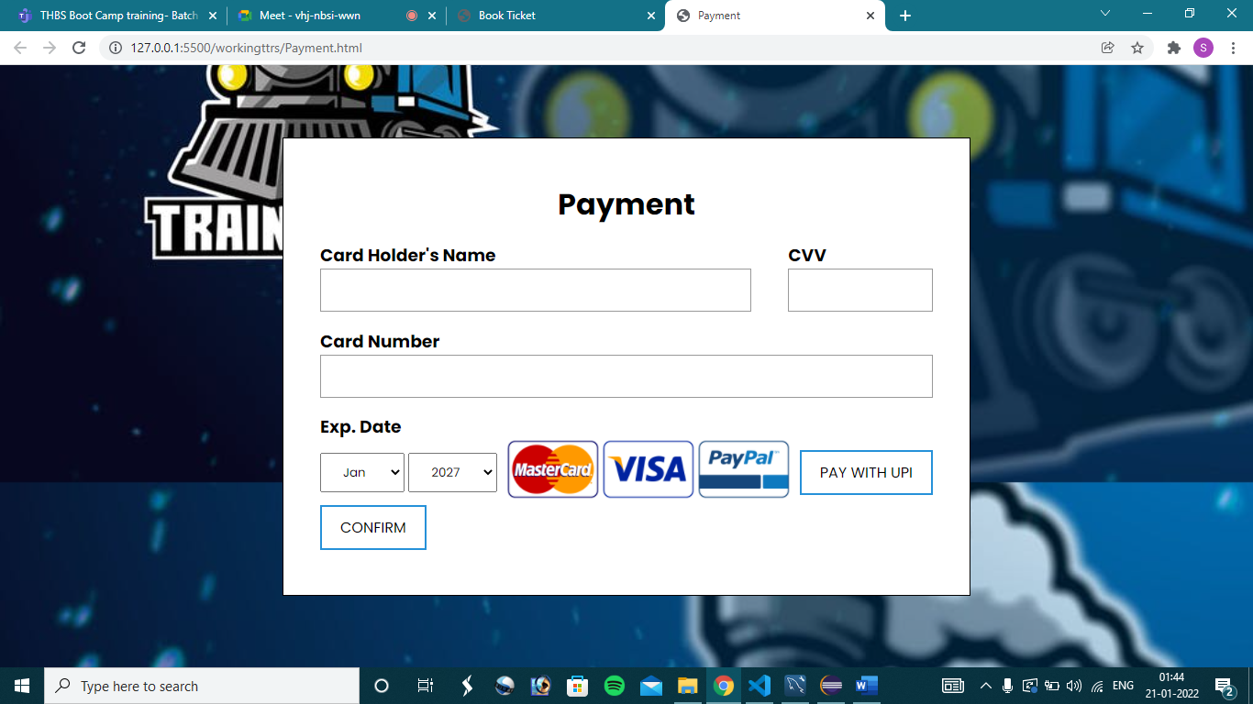

Slide 9
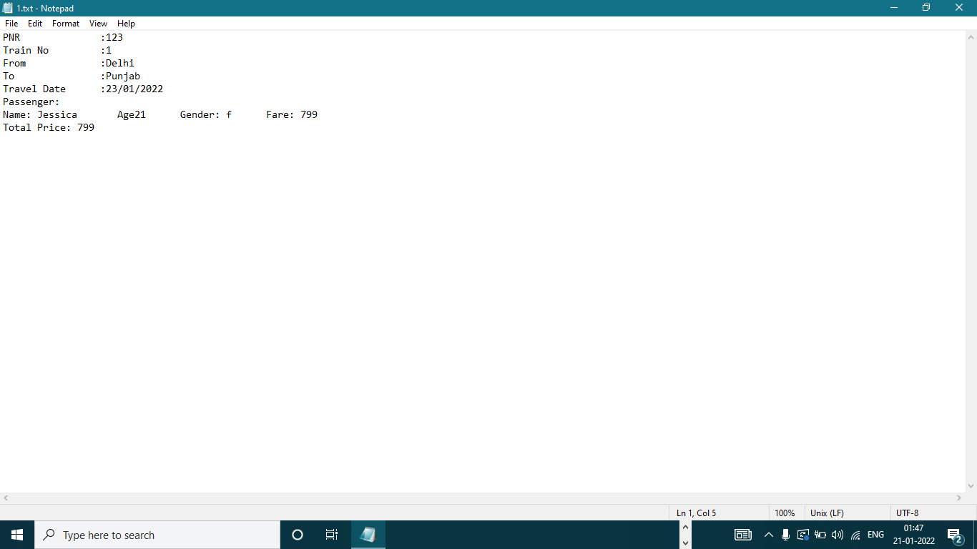

Slide 10
THANKYOU

